Slide 1
Soil remediation strategies
Institutional Affiliation
Course
Date

Slide 2
Introduction: Soil remediation strategies
Soil purity is very important to human and animal lives
Most are the times when soil is subjected to contaminates
Now here we will discuss soil remediation actions or techniques that can be used in different sites
Basically, soil remediation involves purification and revitalization of soil by removing contaminants
This is important in protecting environment and its occupants.
There is a couple of technologies that can be used to remedy a site contaminated with petroleum products in the soil and the groundwater.
The technologies here include
Thermal Desorption
Soil washing
Air Sparging
Encapsulation
Soil vapor extraction
Notes:
This slides introduces us to what soil remediation and some soil remediation strategies as well as the important of soil purity
Soil purity is very important to human and animal lives
A variety of technologies have been discussed
Theses include among others
Thermal Desorption
Soil washing
Air Sparging
Encapsulation
Soil vapor extraction

Slide 3
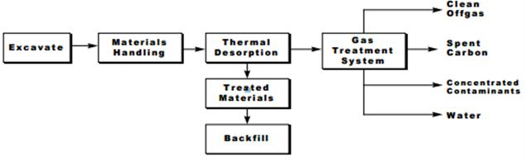
Thermal Desorption technologies
Thermal Desorption is a technology that utilizes heat in vaporization of contaminants
The process of how the thermal desorption works
The process works as follows
Excavating materials
Handling and preparing material for treatment
Thermal Heating of soil by applying heat to desorber
Vaporing contaminant with low boiling points
Collect the contaminants
Outputting soil that is contaminated
Notes:
The slides describes process of how thermal desorption technology works
This technology relies of heat that is applied in desorber.
From thermal desorption as shown in our chart , materials are treated and taken to backfills
Water, contaminants , carbon and clean off-gas are produced from Gas treatment system as you can see in our Diagram

Slide 4
Pros and cons of thermal desorption technology
Cons
High temperatures destroys soil property or minerals as well as organic matter
It is intensive
Sustaining high temperature is costly hence make the process to be more expensive
Limited ability to restore soil
Pros
Time effective technology
Most versatile treatment methods.
Ideal for sites that are to be reused immediately
Appropriate for stringent remedial targets
Effective against a wide range of contaminants
Effective against unknown mixtures of volatile
Notes:
Though effective technology, thermal desorption is associated with some limitation
The technology is applicable where there is a wide range of contaminants and it is ideal for site that are immediately reuse. However, high temperatures causes damage to soil minerals. Sometimes it is costly to sustain high temperature

Slide 5
Feasibility study for thermal desorption
Thermal desorption technique is one of the best method of soil remediation
the applicability of this method depends on consideration some aspects
to use this technologies
Firstly, when using this method, ensure there is minimal emission of metals dust and organic matter.
This may make it more challenging when treating off-gas in the soil.
Secondly, high temperature must be sustained besides vaporization process and this means that, a good budgeting must be done before starting the process
Notes:
Thermal desorption is a technology is highly recommendable method in soil remediation. However, its usage or applicability depends on number of factors like temperature. Finance can be a limitation. It is also associated with environmental problem as it emit some metal dusts. This must be minimized for it to be effective soil remediation.

Slide 6
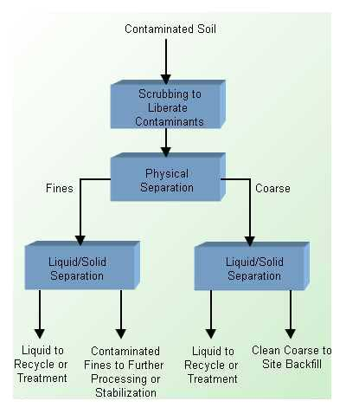
Soil washing technologies
Is the process in which water is used in removing contaminants from the soil.
How does this work?
The process work either by suspending the contaminants or even dissolving them in a wash solution
Soil particles are separated in terms of size through soil washing
Contaminants binds to particles of soils
washing breaks adhesive bonds of particles and small separated particles get disposed
Notes:
This slides describes soil washing technology as a remedial action in soil remediation. As you can see in our flow chart the process begin taking contaminated soil to scrubbing where the materials are liberated are physical separated ( Fine and coarse soils separated).

Slide 7
Pros and cons
pros
cons
Cost effective
Performed in a controlled environment
Time efficient
Demands for a large area
Works with best with on coarse soil.
Not effective in clay or slit soils.
Notes:
Soil washing technology is essential since it is most cost effective and time efficient technology and it can be carried out in a controlled workplace. The problem with this technology is that large area is demanded and works only where the soil is coarse. This means that, very fine soils like silt and clay can make its application ineffective.

Slide 8
Feasibility of soil washing
Soil washing is most appropriate for treating noncomplex soil that contain at least 50% sand and gravel and is relatively ineffective in treating soils that are rich in clay and silt
when settling for a soil remedial technology the following are the conditions that should be considered:
Cost of technology
Type of contamination in question
Regulatory requirements for the technology
Duration of the technology
Operational consideration
Notes:
This is the soli remedial action that is best when dealing with remediation of soil that is not complex. It is best where we have gravel and sand. Soils rich in clay or even silt makes it ineffective. Its applicability depends on cost, type of contamination, and operational consideration. Length duration makes it more expensive

Slide 9
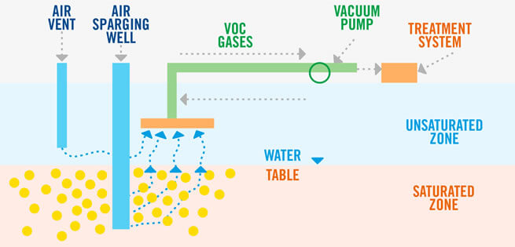
Soil vapor extraction
How does soil vapor technology work?
Firstly Vapor from soil is extracted using soil vapor
Secondly, vacuum is applied to pull vapor out
The air sparging is used to pump air under the ground and extract vapor and any petroleum materials below water table (Liu Song, & Guo, 2018).
Notes:
This technology works where we have saturated and unsaturated zones. The air sparking well is dug to reach saturated zones while air vent is dug to reach unsaturated zones. The materials from these two zones are ejected into voc gases where vacuum pump is applied to pull out vapor and then taken to treatment system

Slide 10
Pros and cons
pros
cons
Its time efficient
Ease of installation due to construction materials being easily available.
Reduced amount of disturbance that occurs at the contamination site
Remedial technology is easily used with other technologies, such as air sparging.
the system can be monitored with ease
Demands for large screen intervals in extraction wells
Soils with high percentage of fines and high degree of saturation requires vacuums thus hindering the operation system
low permeability soils hardly allows for sufficient air flow for the vapors extraction and treatment
applicable only for unsaturated and high permeability soils
Notes:
Soil vapor extraction is a technology that is time efficient, easy to install materials, limited disturbance and can be used with other technologies like air sparging. Besides it is easily monitored. The problem with this technology is that it requires large screen intervals in the extraction wells. Vacuum is required where the soil is fine and its degree of saturation is high. For the permeable soil, hinders the flow of air hence limiting treatment of contaminants

Slide 11
Feasibility
Applicable in volatile compounds.
when settling for a soil remedial technology the following are the conditions that should be considered:
Underground sampling
Cost of technology
Regulatory requirements
Operational consideration
Notes:
Feasibility of this technology
Applicable in volatile compounds.
when settling for a soil remedial technology the following are the conditions that should be considered:
Underground sampling
Cost of technology
Regulatory requirements
Operational consideration

Slide 12
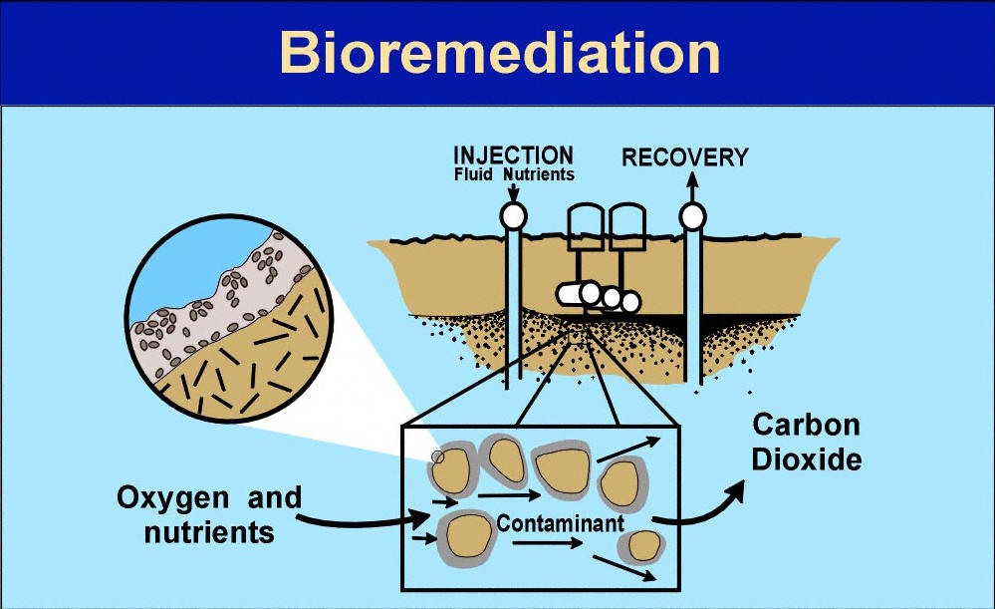
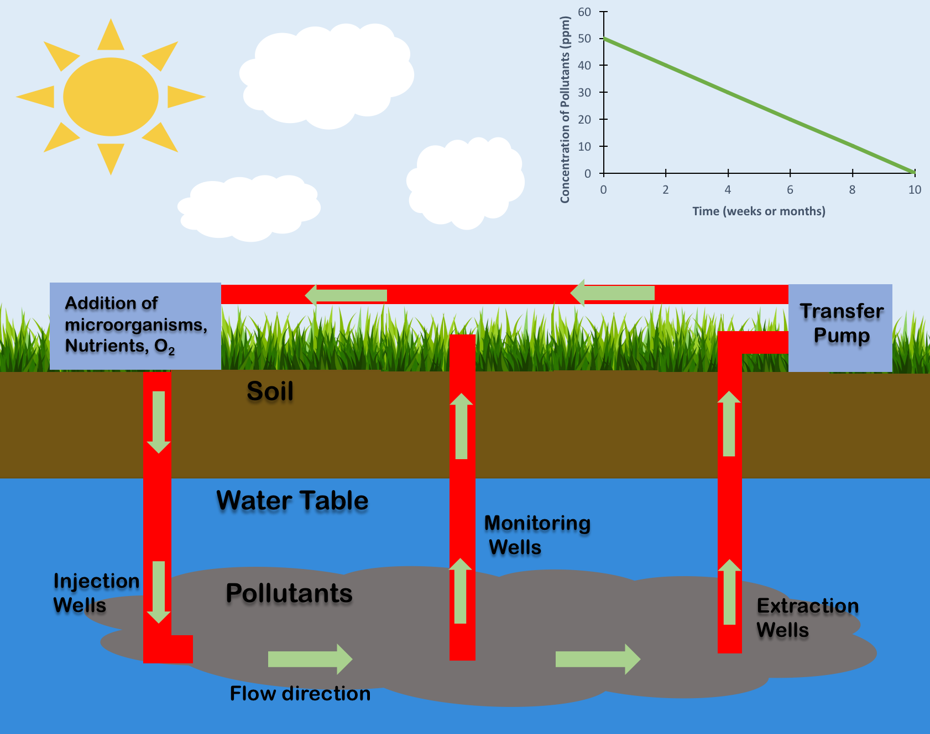
Bioremediation technology
HOW IT WORKS
Here oxygen, nutrients and bacteria are involved in the process
This works by use of microbes
Microbes digests contaminants
They change contaminants water and gases such as carbon (iv) oxide and ethene produced leading to clean up of the contaminants ( Wang, et al, 2016).
The studies shows that, treatment of contaminants by use of bioremediation technology is applicable where we have petroleum products(Azubuike, Chikere, & Okpokwasili, 2016).
Notes:
In bioremediation remedial action microorganism is added into injection well that is below water table where there pollutants. The materials flows in and up monitoring and extraction wells as shown in our chart. In the extraction well, the materials are forced through transfer pump

Slide 13
Pros and cons
pros
cons
Environmental friendly
A low cost alternative
Uses plants such as exogenous metallothionein to remove metals
Soil can lose heavy compounds and metals
Causes minimal disturbance
Better alternative as it doesn't transfer pollutants from one medium to the other
Limited to biodegradable compounds.
Some product are more persistent than parent compound
Takes a longer period compared to other options
Difficult to extrapolate from bench scale and pilot scale studies to full-scale field operations
Notes:
This remedial action is environmental friendly and its cost is comparatively low . Plants are used. It causes little disturbance and it hardly transfer pollutants. The problems in using this technology is that, its is limited to compounds that are biodegradable and can take a very long period compared to other methods

Slide 14
Feasibility of Bioremediation
This technique is considered to be one of the most eco-friendly technology.
Its applicability depends on time and bacteria
Process can take years
This remedial actions depends on reactions within the cells of microbes
It is applicable treating underground water as well as soil with no offsite transportation
It is limited by inability to manipulate chemical and physical environment
Notes:
This technique is considered to be one of the most eco-friendly technology.
Its applicability depends on time and bacteria
Process can take years
This remedial actions depends on reactions within the cells of microbes
It is applicable treating underground water as well as soil with no offsite transportation
It is limited by inability to manipulate chemical and physical environment

Slide 15
Encapsulation
How it works
It works by having Contaminated Soil that is mixed with lime, concrete and cement
This prevents any soil contamination coming from outside. The affected soil is separated to avoid spreading(Nida, Namra & Maham 2018).
Method not suitable if soil is intended for cultivation.
Notes:
This slides shows how encapsulation remedial technology work in soil remediation. In this technology, soil that has been contaminated I mixed with cement and concrete. This is done to prevent and avoid contamination from outside hence the soil that has been affected is separated to limit spreading

Slide 16
Pros and cons of encapsulation
Pros
Cons
Consider as the most effective.
Time efficient
Rectifies heavy metals that are contaminated in the site
Extraction is very favorable
Not suitable if soil is to be used for cultivation
It more of separates than filter
Requires some time for remedial actions to take action
Notes:
Pros and cons for encapsupaltion:
pros
It’s a speedy process doesn’t consumer a lot of time.
When used for its intended purpose its very effective.
Cons
Its found to separate rather than filter the soil –its ameasure that curbs spread than curing the main issue
Not recommended for soil intended for cultivation – limiting its scope

Slide 17
Feasibility study
Before starting encapsulation good assessment should be made on Financial, technical, environmental and social aspects related to it
consider limiting further spread of contaminants or spreading of affected soil
When using this technology soil from the site is not used for growing/cultivating
Whenever, using this technique aspects considered are types of contamination, extent to which area is contaminated, acceptability by public, time of implementing and cost effectiveness
Notes:
Before starting encapsulation good assessment should be made on Financial, technical, environmental and social aspects related to it
consider limiting further spread of contaminants or spreading of affected soil
When using this technology soil from the site is not used for growing/cultivating

Slide 18
References
Azubuike, C. C., Chikere, C. B., & Okpokwasili, G. C. (2016). Bioremediation techniques–classification based on site of application: principles, advantages, limitations and prospects. World Journal of Microbiology and Biotechnology, 32(11), 180
Liu, L., Li, W., Song, W., & Guo, M. (2018). Remediation techniques for heavy metal-contaminated soils: principles and applicability. Science of the Total Environment, 633, 206-219.
Nida T. Khan, Namra J & Maham J. Khan ( 2018). A Brief Overview of Contaminated Soil Remediation Methods
Wang, S. Y., Kuo, Y. C., Hong, A., Chang, Y. M., & Kao, C. M. (2016). Bioremediation of diesel and lubricant oil-contaminated soils using enhanced landfarming system. Chemosphere, 164, 558-567.
Types Of Soil Remediation Techniques For Restoring Soil - Spokane Environmental Solutions. (2019). Retrieved 8 December 2019, from https://www.spokaneenvironmental.com/soil-remediation-types-techniques/

